Slide 1
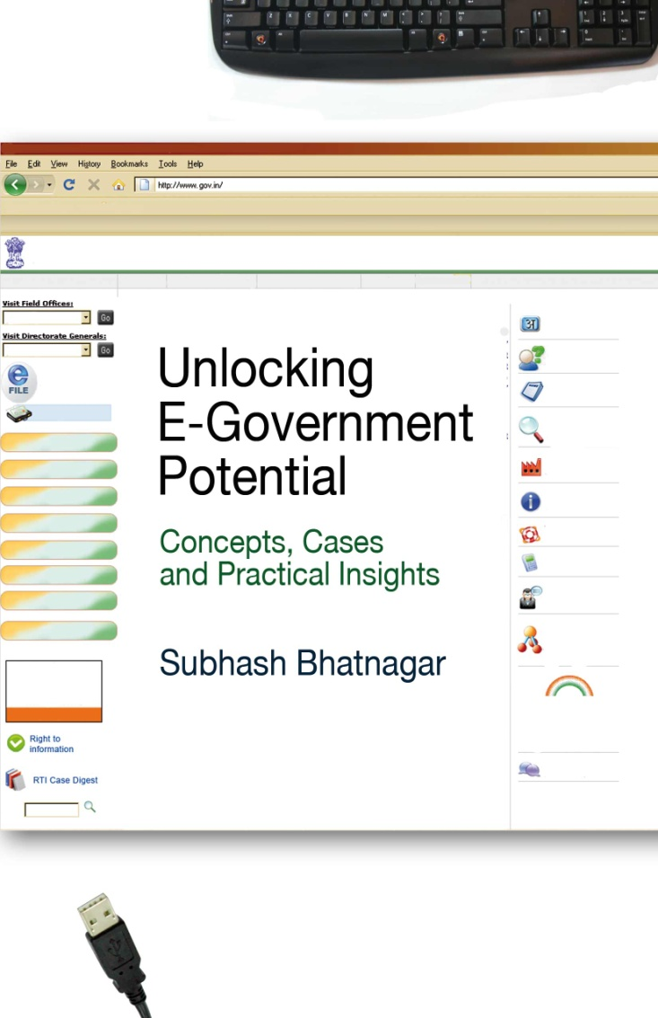
Email: subhash@imahd.ernet.in
Home Page: http://www.iimahd.ernet.in/~subhash
Blog: www.subhashbhatnagar.com
Issues in Impact Assessment
Case Studies of IIMA Programs and Indian eGovernance Projects

Slide 2
Presentation Structure
Why Impact Assessment?
Issues and Challenges in Impact Assessment
Methodology Used in IIMA Educational Programs
Assessment of Indian eGovernance Projects
  Developing a framework
  Design of methodology
  Analysis of results and reporting
  Learning from the assessment
Summary and Overall Conclusions

Slide 3
Why Impact Assessment?
To ensure that resources deployed in programs/projects provide commensurate value.
To create a bench mark for future projects to target
To identify successful projects for replication and scaling up
To sharpen goals and targeted benefits for each project under implementation
To make course correction for programs under implementation
To learn key determinants of economic, organizational, and social impact from successful and failed projects

Slide 4
Issues and challenges in evaluation/impact assessment
“Confusion between monitoring, evaluation and impact assessment”
“Systematic analysis of lasting changes-positive/negative in beneficiary’s life and behaviour”
“Macro versus Micro Approach - unit of analysis”
“How to isolate the effect of different interventions ?
”
“Assessment from whose perspective?
”
“Can all benefits be monetized? Degree of quantification versus qualitative assessment
”
“Why do different assessments of the same project provide widely differing results?”
”Which methodology-survey, ethnographic, focus group, exit polls, expert opinion”
”Handling counterfactuals”
Notes:
Before going into the question of strategies, you must be aware of WHY some country wants to put effort into e-government. Which are their motives? What driving forces make a country work with e-government?
The motives could be multiplied
No matter what motive you have, you should be aware of it, because the answer to the question WHY do have a great impact on your strategy

Slide 5
Results from Two eGovernance Studies
DIT 3 Projects 12 States Study
  Computerization of land records
  Registration of Property deeds
  Transport: Vehicle registration and drivers license
IIMA/DIT/World Bank Study
  Issue of land titles in Karnataka (Bhoomi)
  Property registration in AP, Karnataka (Kaveri)
  Computerized Treasury (Khajane):
  eSeva center in Andhra Pradesh: 250 locations in 190 towns, Used monthly by 3.5 million citizens (8-01)
  e-Procurement in Andhra Pradesh (1-03)
  Ahmedabad Municipal Corporation (AMC)
  Inter State Check Posts in Gujarat: 10 locations (3-2000)

Slide 6
Evolving a Framework: Learning from Past Assessments
Variety of approaches have been used-client satisfaction surveys, expert opinion, ethnographic studies
Client satisfaction survey results can vary over time as bench mark changes - need for counterfactuals
Biased towards quantification of short term direct cost savings- quality of service, governance and wider impacts on society not studied.
Often studies have been done by agencies that may be seen as being interested in showing positive outcome
Different studies of the same project show very different outcomes
Lack of a standard methodology-makes it difficult to compare projects. Hardly any projects do a benchmark survey
Variety in delivery models has not been recognized. Impact is a function of the delivery model and the nature of clients being served

Slide 7
Dimensions to be Studied Depend on Purpose of Evaluation
Project context: basic information on the project and its context
Inputs (technology, human capital, financial resources);
Process outcome (reengineered processes, shortened cycle time, improved access to data and analysis, flexibility in reports);
Customer results (service coverage, timeliness and responsiveness, service quality and convenience of access);
Agency outcomes (transparency and accountability, less corruption, administrative efficiency, revenue growth and cost reduction) and
Strategic outcomes (economic growth, poverty reduction and achievement of MDGs).
Organizational processes: institutional arrangements, organizational structure, and other reform initiatives of the Government that might have influenced the outcome for the ICT project.

Slide 8
Proposed Framework
Focused on retrospective assessment of benefits to users (citizens/businesses) from e-delivery systems(B2C/B2B) in comparison to existing system
Recognizes that some part of the value to different stakeholders can not be monetized
Data collection was done through survey based on recall of experience of the old system

Slide 9
E-Government Benefits to Clients
Reduced transaction time and elapsed time
Less number of trips to Government offices
Expanded time window and convenient access
Reduced corruption-need for bribes, use of influence
Transparency-clarity on procedures/documents
Less uncertainty in estimating time needed
Fair deal and courteous treatment
Less error prone, reduced cost of recovery
Empowered to challenge action-greater accountability

Slide 10
Survey Items for Measurement of Impact on Users
Cost of Availing Service Measured Directly
Number of trips made for the service
Average travel cost of making each trip
Average waiting time in each trip
Estimate of wage loss due to time spent in availing the service
Total time elapsed in availing service
Amount paid as bribe to functionaries
Amount paid to agents to facilitate service
Overall Assessment
Preference between manual and computerized systems
Composite Score: Measured on 5-point scale factoring in the key attributes of delivery system seen to be important by users
Quality of Service Interaction with staff, complaint handling, privacy, accuracy- measured on 5-point scale measured on a 5-point scale Quality of Governance Corruption, accountability, transparency, participation measured on a 5-point scale

Slide 11
Sampling Methodology
Sample frame and size was selected so that results could be projected to the entire population
About 16 service delivery points were chosen on the basis of activity levels, geographical spread and development index of catchments
Respondents were selected randomly from 20 to 30 locations stratified by activity levels and remoteness
Data collected through structured survey of users of both the manual and computerized system
Randomly selected sample of 600 to 800 respondents in State level projects and 7-8000 in National projects

Slide 12
Questionnaire Design and Survey
Design of analytical reports prior to survey. Often key variables can be missed if the nature of analysis in not thought through prior to the study.
Pre-code as many items in the questionnaire as possible.
Consistent coding for scales - representing high versus low or positive versus negative perceptions.
Differently worded questions to measure some key items/perceptions.
Wording of questions should be appropriate to skill level of interviewer and educational level of respondent.
Local level translation using colloquial terms.
Feedback from pre-testing of questionnaire should be discussed between study team and investigators. The feedback may include: the length of questionnaire, interpretation of each question and degree of difficulty in collecting sensitive data.
Quality of supervision by MR agency is often much worse than specified in the proposal. Assessing the quality of investigators is a good idea.
Involvement of study team during the training of investigators.
Physical supervision by study team of the survey process is a good idea, even if it is done selectively

Slide 13
Presentation of results

Slide 14
NUMBER
OF
TR
I
PS
LAND
RECORD
MANUAL | SAVING
2.77 | 1.00
5 OUT OF 10 ALMOST AT OPTIMAL LEVEL
 | MANUAL
 | COMPUTERISED
MANUAL | SAVING
3.96 | 1.61
2 OUT OF 11 AT OPTIMAL LEVEL
PROPERTY
Functionary not available
Incomplete application
Counter was not operational-power or system failure
Document not ready
Very long queue(s)
Application form was not available
Procedure not clear to client
Mismatch in delivery capacity and demand
Too many documents required from client
No appointment system
TRANSPORT
MANUAL | SAVING
3.44 | 1.00
2 OUT OF 11 AT OPTIMAL LEVEL

Slide 15
WA
I
T
I
N
G
T
I
M
E
LAND
RECORD
MANUAL | SAVING
142 | 40
 | MANUAL
 | COMPUTERISED
(MINUTES)
MANUAL | SAVING
148 | 62
PROPERTY
Long/badly managed queue
Some counters not operational
Slow processing at service center
Power breakdown/ system failure
Too many windows to visit
TRANSPORT
MANUAL | SAVING
130 | 36

Slide 16
LAND
RECORD
MANUAL | SAVING
39 Avg Bribe | 16 Rs 89
%
P
A
Y
I
N
G
B
R
I
B
E
S
 | MANUAL
 | COMPUTERISED
( ) | % USING AGENTS
(46)
(44)
(17)
MANUAL | SAVING
23.18 Avg. Bribe | 6.13 Rs. 1081
PROPERTY
(68)
(61)
(41)
To expedite the process
To enable out of turn service
Additional convenience
Influence functionaries to act in your favor
Functionaries enjoy extensive discretionary power
Complex process requiring use of intermediary by client
(7)
(2)
TRANSPORT
MANUAL | SAVING
17 Avg. Bribe | 4.2 Rs. 184
(53)
(48)
(20)
(21)
(14)
(14)
(5)

Slide 17
Impact of Computerized System on Key Dimensions
TRIPS SAVED: 1.1
WAITING TIME SAVED: 42 MINS
REDUCTION IN PROPORTION PAYING BRIBE: 7%
DIRECT COST SAVING: 69 RS
IMPROVEMENT IN SERVICE QUALITY SCORE: 1.0
IMPROVEMENT IN GOVERNANCE SCORE: 0.8
Manual
Computerized

Slide 18



Project-wise Impact
 | Land Record Computerization | Property Registration | Transport Offices
 | NUMBER OF TRIPS
 | 3.2 ➔ 2.0 | 3.9 ➔ 2.3 | 3.4 ➔ 2.4
 | WAITING TIME (MIN)
 | 128 ➔ 92 | 133 ➔ 77 | 120 ➔ 90
 | % PAYING BRIBE
 | 38 ➔ 25 | 23 ➔ 19 | 17 ➔ 13

Slide 19
Importance of Service Delivery Attributes for the Three Applications

Slide 20
Overall Assessment (State-wise)
West Bengal
Orissa
Gujarat
Delhi
Punjab
Haryana
Madhya Pradesh
Uttarakhand
Tamil Nadu
Kerala
Rajasthan
3
Himachal Pradesh
1
5
1 - Much worsened; 3 - No change; 5 - Much improved

Slide 21
DIT/World Bank Study of 8 Projects

Slide 22
Number of Trips

Slide 23
Proportion Paying Bribes (%)

Slide 24
Improvement Over Manual System
 | Bhoomi | Kaveri | CARD | eSeva | E-Proc | AMC | Checkpost
Total Travel Cost per transactıon (Rs.) | (8.51) | 116.68 | 39.63 | 9.34 | 1444.55 | 21.85 | N.A.
Number of trips | 0.47 | 1.20 | 1.38 | 0.29 | 0.86 | 0.65 | N.A.
Wage Loss (Rs.) | (39.22) | 120.55 | 28.46 | 15.63 | N.A. | 36.84 | N.A.
Waiting Time (Minutes) | 41.21 | 62.62 | 96.24 | 18.50 | 114.95 | 16.16 | 8.87
Governance Quality - 5 point scale | 0.76 | 0.19 | 0.61 | 0.79 | 0.38 | 0.75 | 0.88
Percentage paying bribes | 33.08 | 12.71 | 4.31 | 0.40 | 11.77 | 2.51 | 6.25
Service Quality- 5 point scale | 0.95 | 0.32 | 0.48 | 0.95 | 0.27 | 0.70 | 0.57
Error Rate | 0.78 | 3.79 | 0.86 | 1.58 | N.A. | 0.41 | N.A.
Preference for Computerization (%) | 79.34 | 98.31 | 96.98 | 96.84 | 83.71 | 97.49 | 91.25

Slide 25
Savings in Cost to Customers
Estimates for entire client population
Projects | Million Transactions | Travel Cost Saving (Rs. Million) | Wage Loss (Rs. Million) | Waiting Time (Million Hours) | Bribes (Rs. Million) | Other Payment to Agents (Rs. Million)
Bhoomi | RTC-11.972 MUT-1.032 | (1041.24) | (470.277) | (0.256) | 180.312 | 124.870
KAVERI | 2.471 | 220.480 | 297.918 | 1.059 | (125.074) | 6.283
Khajane | 3.525 | 64.847 | 17.937 | 142.404 | 7.807 | 15.614
CARD | 1.033 | 69.910 | 29.385 | 1.665 | (57.549) | (38.719)
eSeva | 37.017 | 274.095 | 578.556 | 11.468 | N.A. | N.A.
e-Procurement | 0.026 | 90.726 | N.A. | 0.051 | 3.536 | (0.156)
AMC | 0.713 | 15.027 | 26.273 | 0.151 | 1.092 | 2.357
Checkpost | 16.408 | N.A. | N.A. | 2.444 | 217.741 | 52.641

Slide 26
Projects: Descending Order of Improvement in Composite Scores on a 5 point scale
Project | Manual |  | Computer |  | Difference Average
 | Average | S.D. | Average | S.D.
Bhoomi | 2.86 | 0.86 | 4.46 | 0.51 | 1.60
eSeva | 3.39 | 0.65 | 4.66 | 0.39 | 1.27
e-Procurement | 3.22 | 0.58 | 4.26 | 0.58 | 1.04
Checkpost | 3.48 | 0.79 | 4.32 | 0.59 | 0.84
AMC | 3.37 | 0.61 | 4.12 | 0.90 | 0.75
KAVERI | 3.35 | 0.86 | 3.90 | 0.74 | 0.55
CARD | 3.78 | 0.49 | 3.93 | 0.38 | 0.15

Slide 27
Bhoomi
KAVERI
Khajane - DDO
Khajane - Payee

Slide 28
CARD
eSeva
E-Procurement
AMC

Slide 29
Checkpost

Slide 30
Preliminary Observations
Overall Impact
  Reasonable positive impact on cost of accessing service
  Variability across different service centers of a project
  Per transaction operating costs including amortized investment is less than benefit of reduced costs to customers. User fees can be charged and projects made economically viable.
Reduced corruption-outcome is mixed and can be fragile
  Any type of system break down leads to corruption
  Agents play a key role in promoting corruption
  Private operators also exhibit rent seeking behavior given an opportunity
Strong endorsement of e-Government but indirect preference for private participation
Small improvements in efficiency can trigger major positive change in perception about quality of governance.
Challenges
  No established reporting standards for public agencies- In case of treasuries, the AG office has more information on outcome.
  What is the bench mark for evaluation-improvement over manual system, rating of computerized system (moving target), or potential?
  Measuring what we purport to measure: design of questions, training, pre test, field checks, triangulation
  Public agencies are wary of evaluation-difficult to gather data

Slide 31
Key Lessons
Number of mature projects is very limited. A long way to go in terms of coverage of services/states
Most projects are at a preliminary stage of evolution.
Even so, significant benefits have been delivered. Need to push ahead on eGovernance agenda
Need to Push Hard on the e-Governance Agenda
However, variation in project impact across states suggests
  that greater emphasis on design and reengineering is needed.
  need to learn from best practices elsewhere
Need for building capacity to conceptualize and implement projects

Slide 32
Establishing Data Validity
Check extreme values in data files for each item and unacceptable values for coded items.
Cross-check the data recorded for extreme values in the questionnaire.
Check for abnormally high values of Standard Deviation.
Even though a code is provided for missing values, there can be confusion in missing values and a legitimate value of zero.
Look for logical connections between variables such as travel mode and travel time; bribe paid and corruption.
Poor data quality can often be traced to specific investigators or locations.
Random check for data entry problems by comparing data from questionnaires with print out of data files.
Complete data validity checks before embarking on analysis

Slide 33
Points to Remember – Client Assessment
‘What Ought to be measured’ versus ‘What Can be measured’.
Accurately Measurable Data versus Inaccurately Measurable Data.
How to measure the ‘Intangible benefits/losses’ – The Impact on client ‘Values’.
For some variables perception ratings provide a better measure rather than actual figures (such as: measuring the effort required for documentation)
Data Triangulation. Validation of client data through:
  Actual observation of measurable data such as waiting time
  Studying correlations between variables such as distance & cost
Selecting representative sample on the basis of
  Location
  Activity levels of center
  Economic status
  Rural/urban divide, etc.

Slide 34
Benefits to Agency
Reduced cost of delivering service-manpower, paper, office space
Reduced cost of expanding coverage and reach of service
Growth in tax revenue-coverage and compliance
Control of Government expenditure
Improved image( service, corruption and fraud)
Improved monitoring of performance and fixing responsibility
Improved work environment for employees
Better quality decisions

